Slide 1



Electrical
Engineering
Association
DIGI
WARE
PROJECT

Slide 2
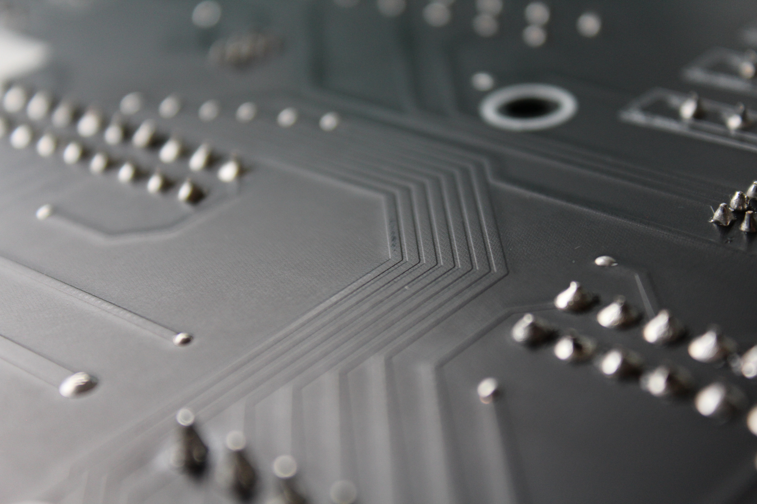
OUR TEAM
Ayan Gupta
Saladi Teja Sri
Sukhada Patil
MENTORS:
•Meenakshi Mondal
220258
220941
220761
•Shreeja Mantapuram
Pranshu Thirani
Arpita Chaurasia
•Adrija Bera
220801
220207

Slide 3
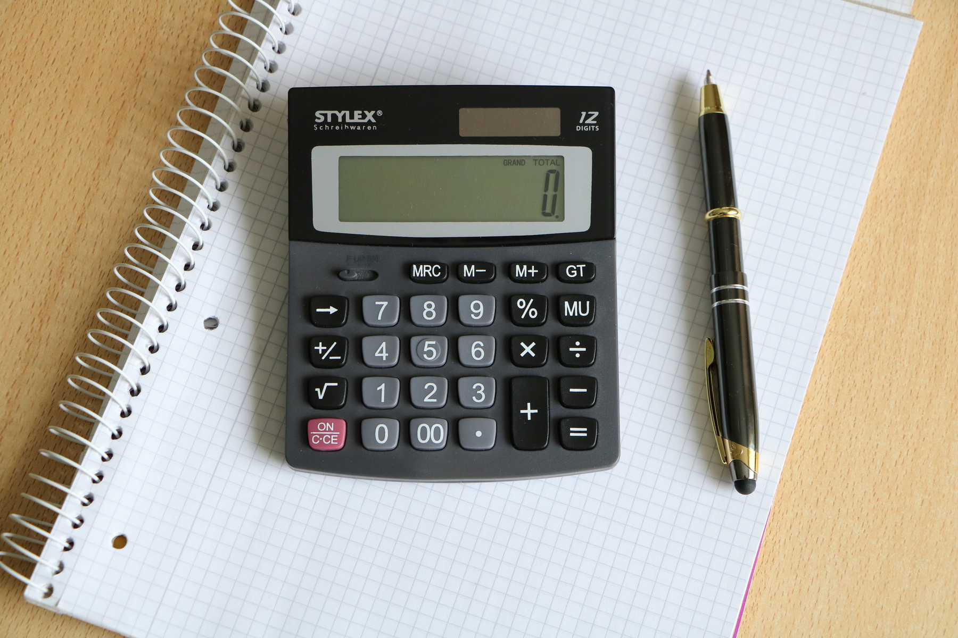



SCIENTIFIC CALCULATOR
PROBLEM STATEMENT
Design a basic calculator which takes two single-digit numbers (each is a single-digit decimal base number entered by user)as input and can perform unsigned addition, subtraction, multiplication and division (only quotient) based on user selection and display the output decimal number (two digits) to the user .

Slide 4





OBJECTIVES
01
To design a basic CALCULATOR which takes two single digit numbers as input.
02
The calculator should perform the desired operation(among addition,subtraction,multiplication,division).
03
It should give two digit decimal number as output.

Slide 5
Cracking the Nut of the Module
Module name: calc
Inputs:
en: Enable signal (active high)
in1: First operand (4-bit)
in2: Second operand (4-bit)
ops: Operation selector (2-bit)
Outputs:
total: Result of the calculation (8-bit)

Slide 6
Test bench
Module name: calc_tb
Inputs:
Test cases for each of the operations- addition, subtraction, multiplication and division are created and tested
en: Enable signal (active high)
in1: First operand (4-bit)
in2: Second operand (4-bit)
ops: Operation selector (2-bit)
Outputs:
total: Result of the calculation (8-bit)

Slide 7
Cracking the Nut of the Module
Module name: add
Inputs:
in1: First operand (4-bit)
in2: Second operand (4-bit)
Outputs:
out: Result of addition (8-bit)

Slide 8
Cracking the Nut of the Module
Module name: sub
Inputs:
in1: First operand (4-bit)
in2: Second operand (4-bit)
Outputs:
out: Result of subtraction (8-bit)

Slide 9
Cracking the Nut of the Module
Module name: multiply
Inputs:
in1: First operand (4-bit)
in2: Second operand (4-bit)
Outputs:
out: Result of multiplication (8-bit)

Slide 10
Cracking the Nut of the Module
Module name: div
Inputs:
in1: First operand (4-bit)
in2: Second operand (4-bit)
Outputs:
out: Result of division (8-bit)

Slide 11


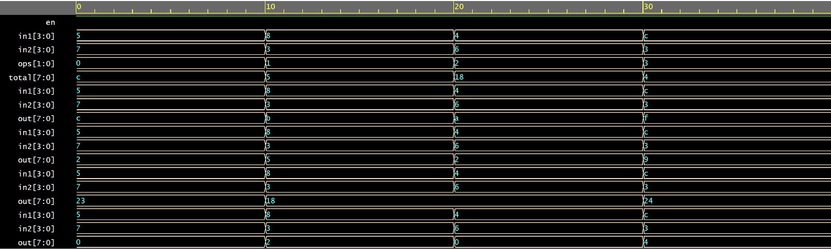
WAVEFORM
en is high(active)
Duration of Wave Form: 0 seconds to 40 seconds.

Slide 12
WAVEFORM
en is high(active)
Operation(ops) Output(total)
0 Addition
1 Subtraction
2 Multiplication
3 Division
Displaying Output in the Hexadecimal System

Slide 13
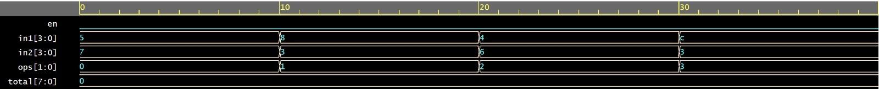
WAVEFORM
en is low(inactive)
Inactivity of the system results in zero output, regardless of the input, when the enable(en) is low.
Duration of Wave Form: 0 seconds to 40 seconds.

Slide 14

Thank You !!

